Slide 1
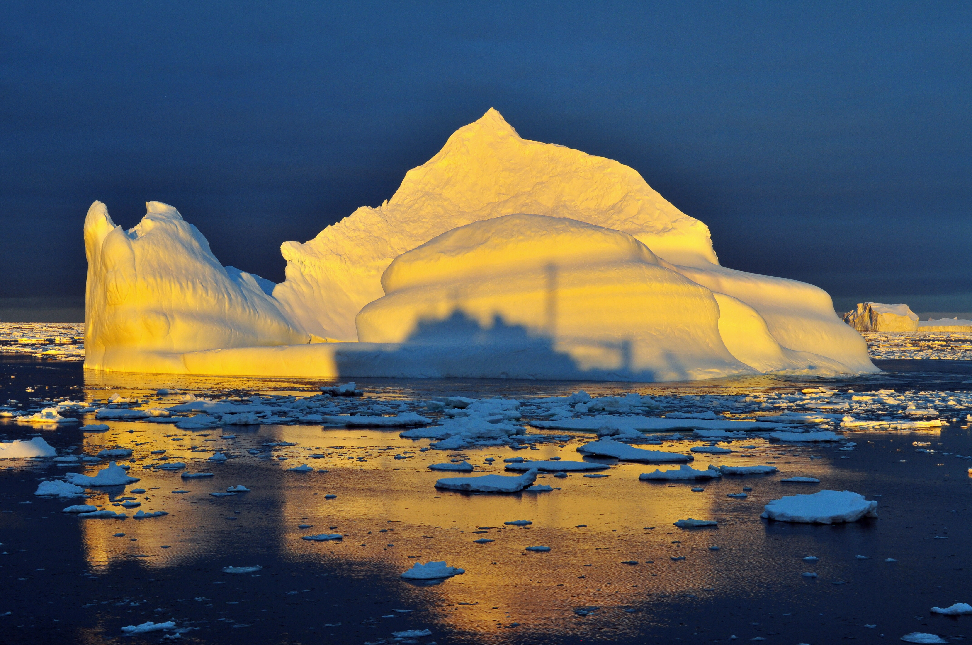
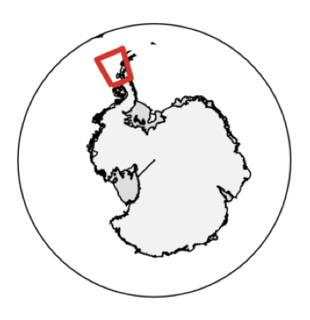


Ecological Response to “Press-Pulse” Disturbances Along a Rapidly Changing West Antarctic Peninsula
Representing efforts of many
over decades

Slide 2
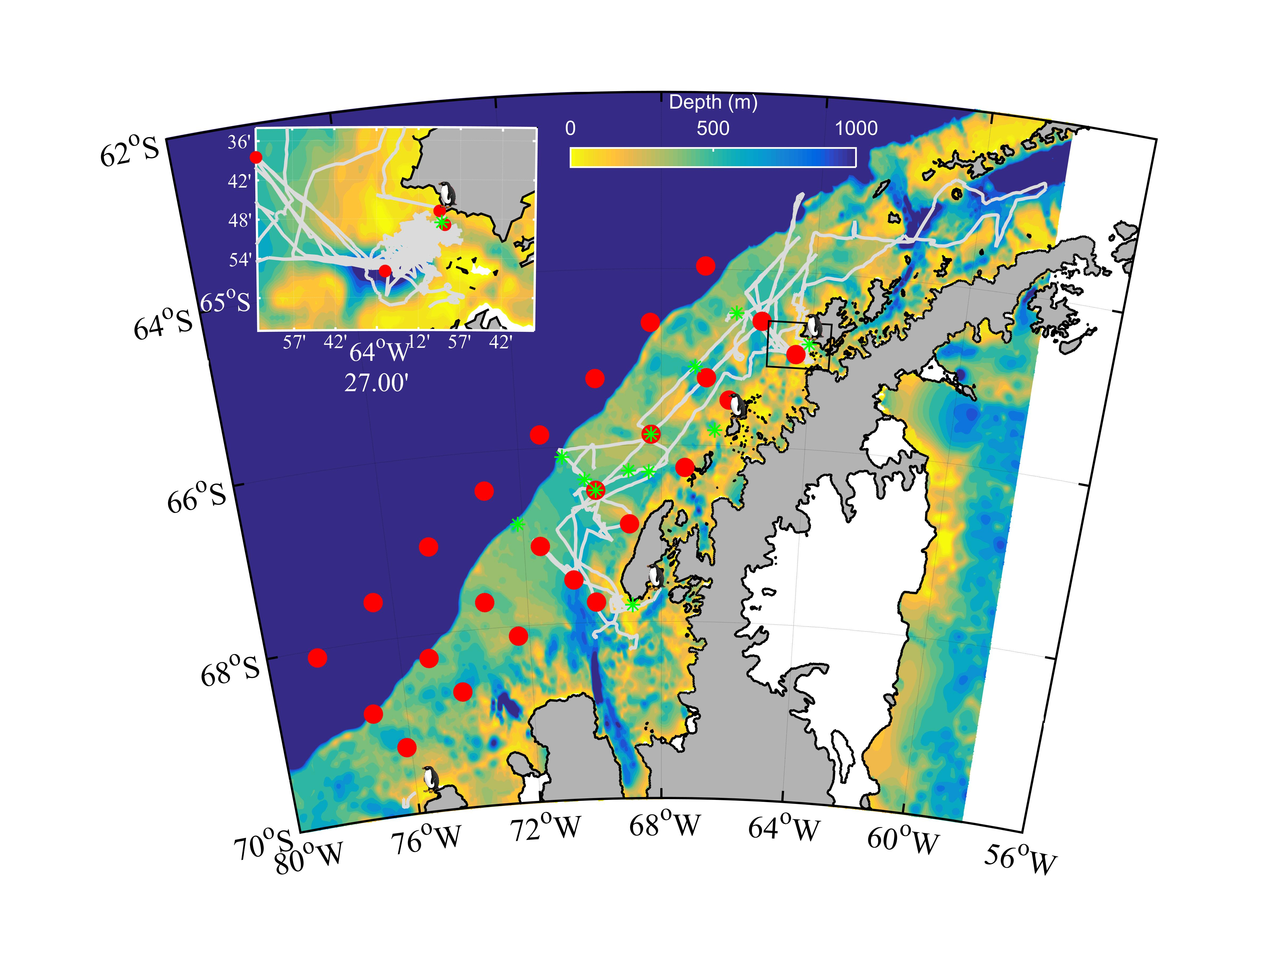
A System Undergoing Change and A Model System
For Changing Polar Food Webs
Warmer
Maritime
Climate
- Across the Climate Gradient There Are Multiple International Time Series
- Time Series Have Been Conducted Across Trophic Levels
Cold Dry
Polar
Climate
- Combined Data Provides The Unique Snapshot Of The Ecosystems At Different Stages of Change
Peninsula Spans a Climate Gradient

Slide 3
What are our predictions?
Transitional Period
Phytoplankton Biomass
Heavy Sea Ice
Short Growing
Season
No Sea Ice
Deep Wind
Mixing
Time

Slide 4
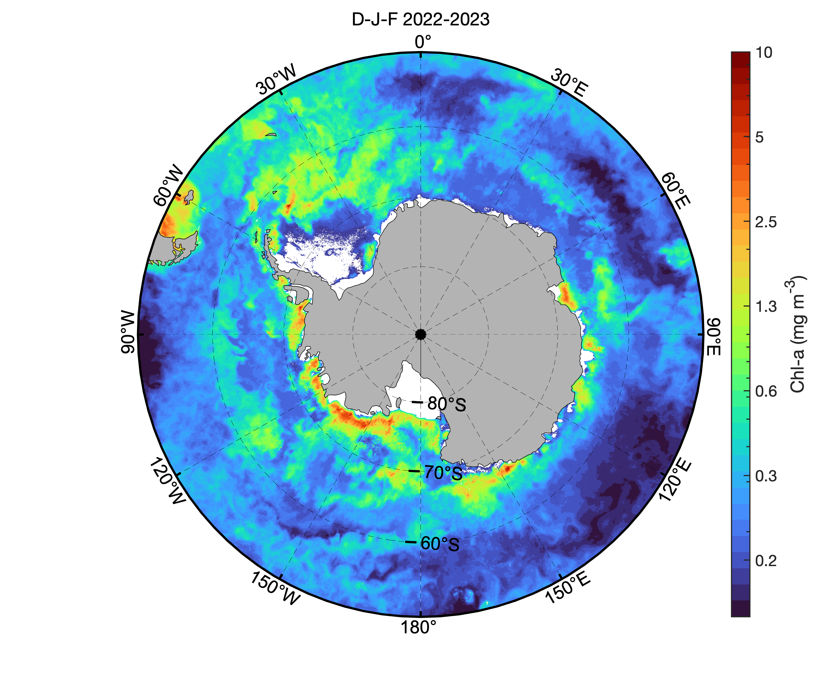
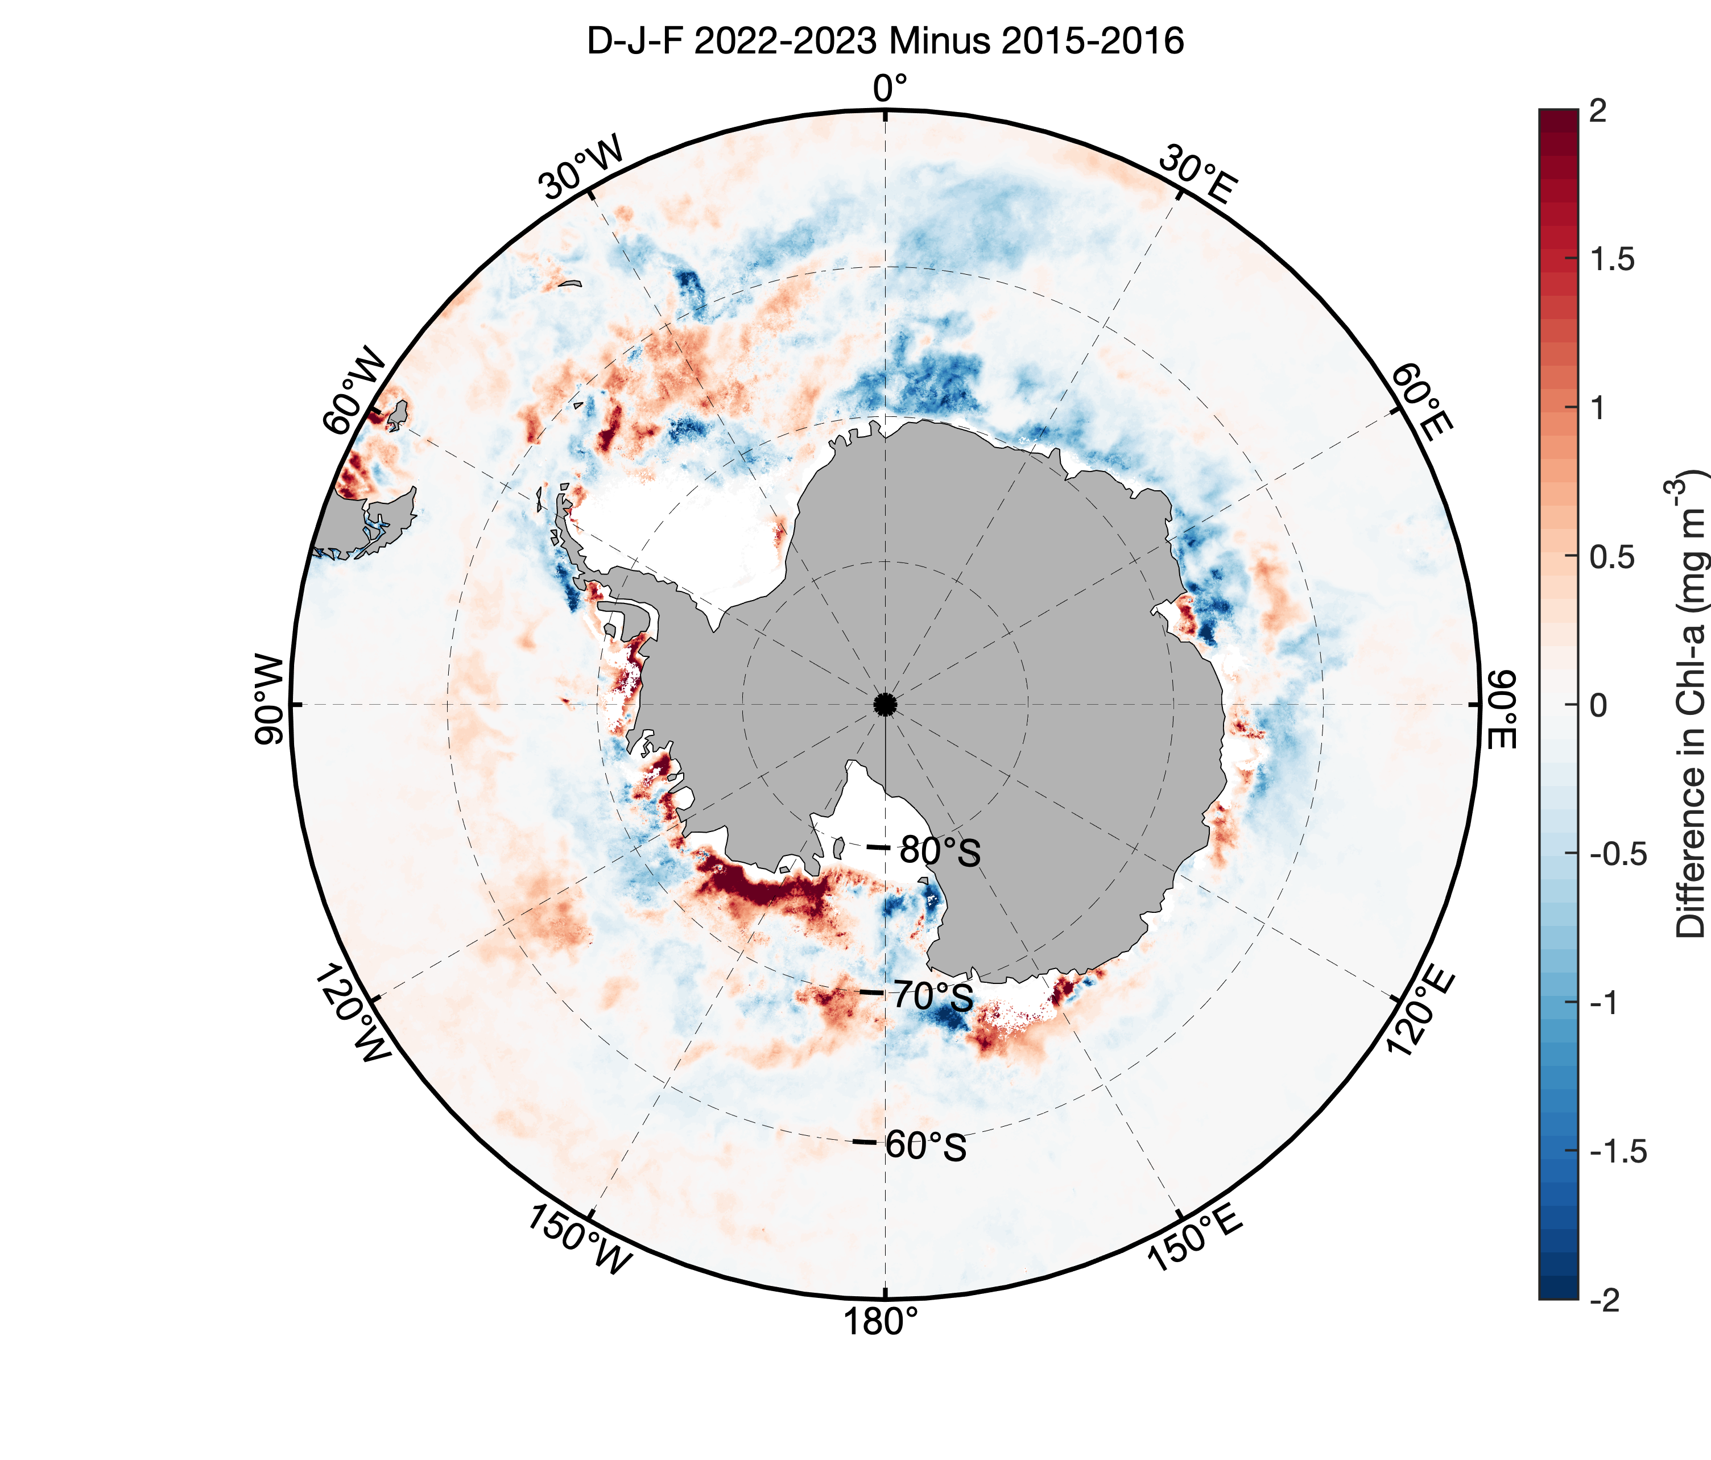
Biological impact?
View this year, Legacy effects?
The lowest ice year record was
expressed differentially across
Antarctic as a whole
Thanks Jessie Turner (U CONN)

Slide 5
Regional Responses in Phytoplankton

Slide 6
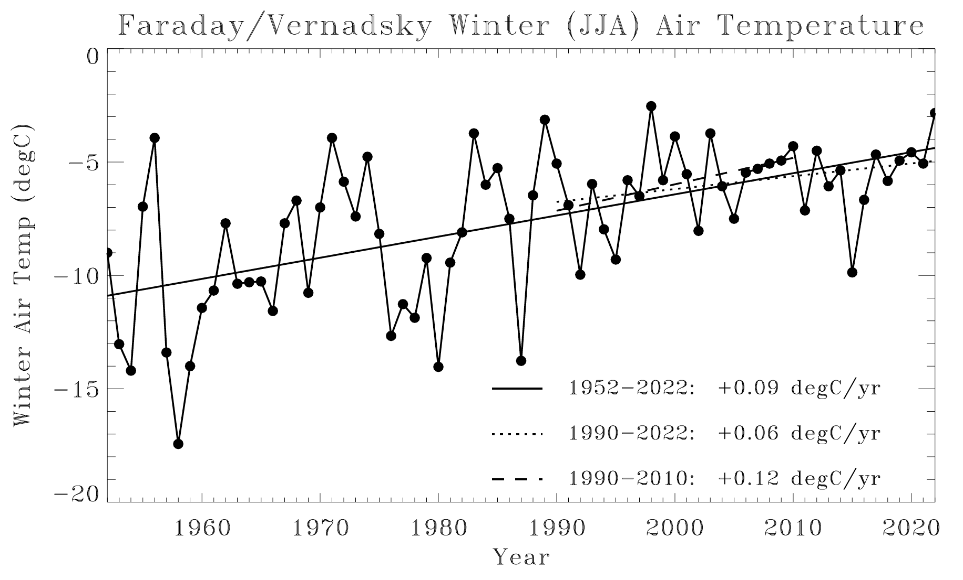
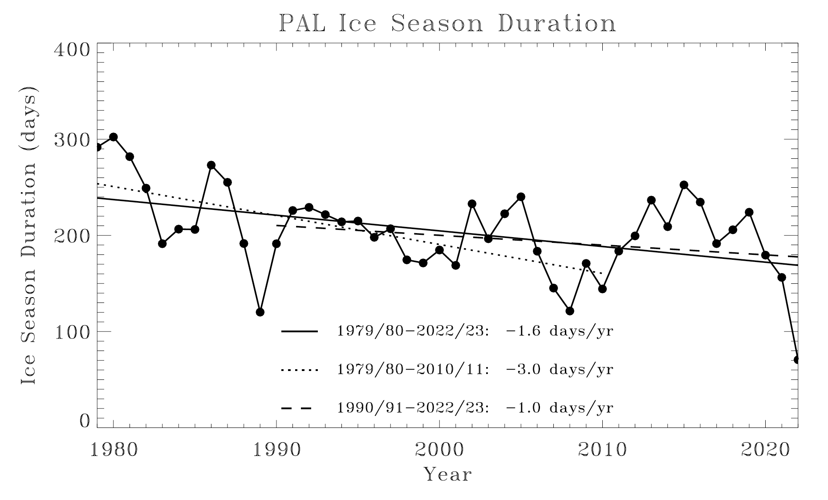
A System Experiencing Change
-Increasing Winter Atmospheric Temperatures
-Overtime Decreasing Variability
-Overtime Declining Sea Ice Duration
-Cyclical Patterns Associated With the Phasing
of the Climate Cycles

Slide 7
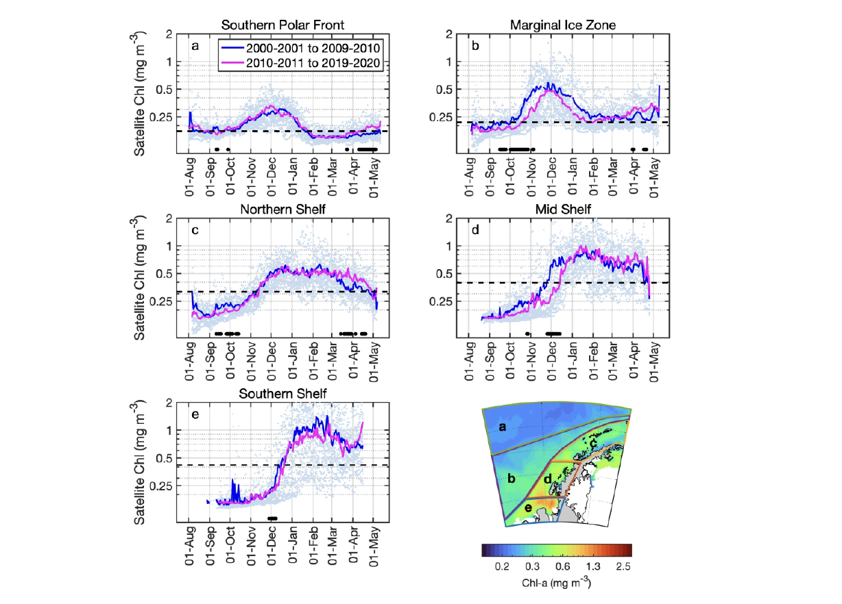
Seasonal Phenology in Chlorophyll With Trended Change
Turner et al. revision submitted
Global Change Biology

Slide 8
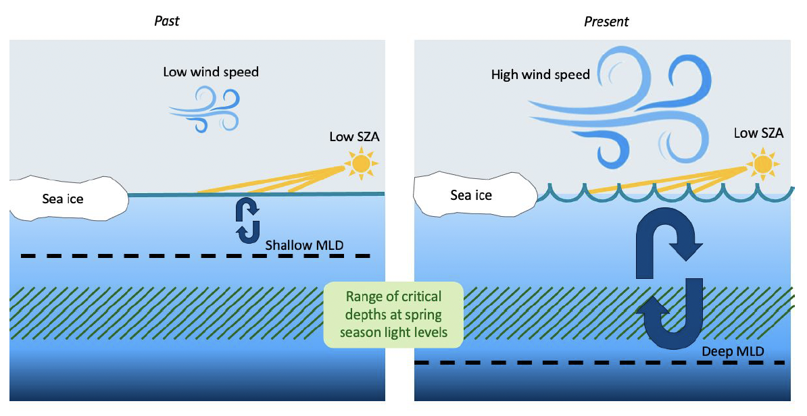
Why Later Blooms?

Slide 9
Shelf Responses in Phytoplankton

Slide 10
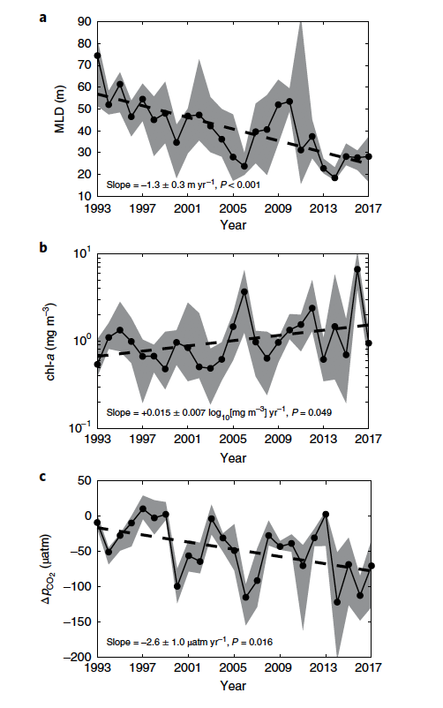
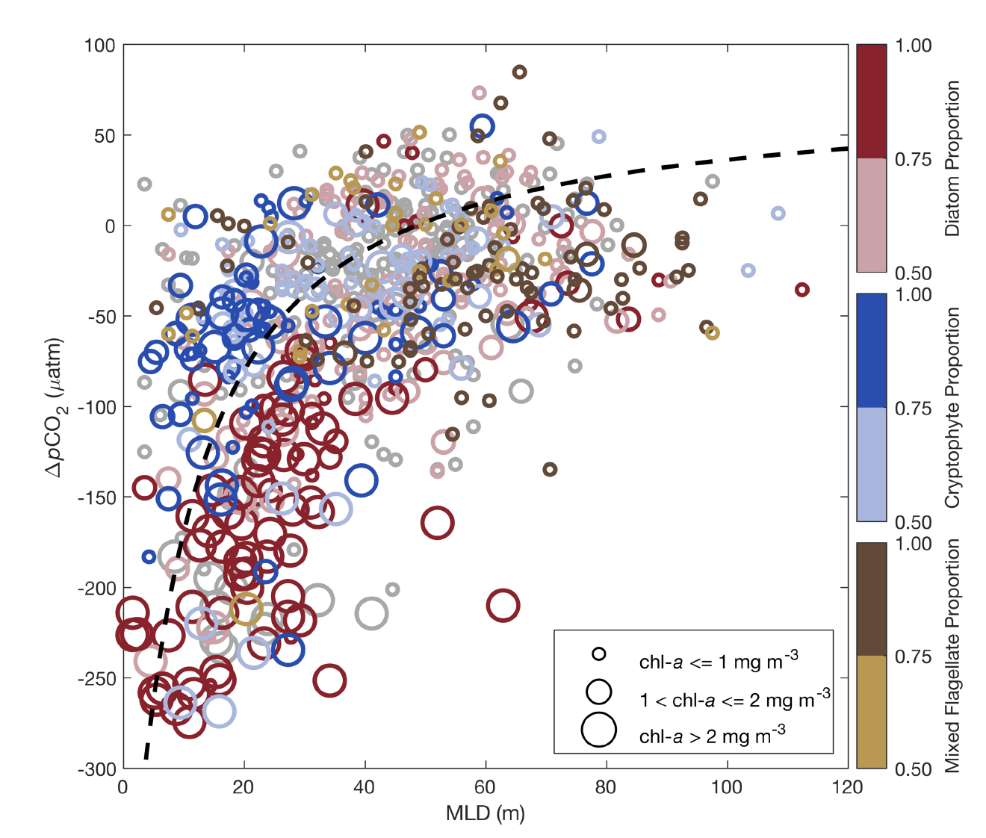
The Physical Changes Are Correlated With Changes in Phytoplankton Biomass and Associated Drawdown of Atmospheric Carbon Dioxide. Phytoplankton Community is Important.
Upper Mixed
Layer
Delta
pCO₂
Chl a
Delta
pCO₂
Upper Mixed Layer
Brown et al. 2019

Slide 11
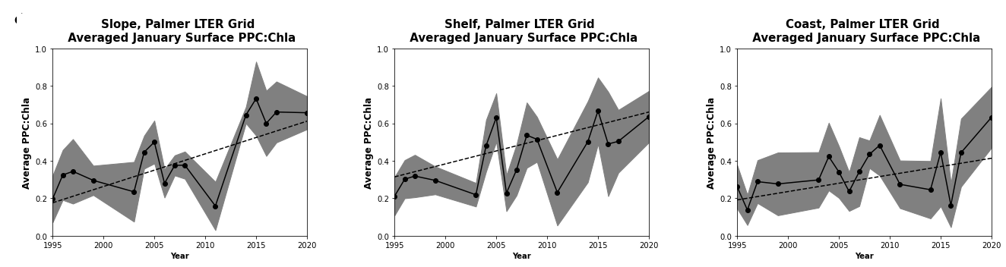
Physiological Fingerprints of Change:
Phytoplankton are ”tanning” as the stratification increases

Slide 12
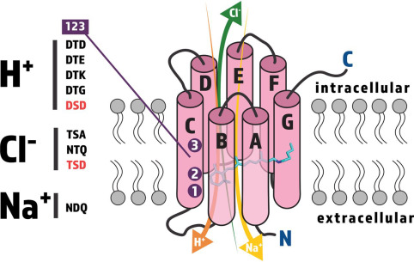
Evolutionary Fingerprint of Light Acclimation to this environment
Proton pumping rhodopsin in WAP diatoms
PPR is pervasive in Antarctic phytoplankton, especially in iron-limited regions. In diatoms, it can localize to the vacuolar membrane, making the vacuole a possible alternative phototrophic organelle for light-driven production of cellular energy
Andrews et al. Revision resubmitted to PNAS

Slide 13
Local Responses in Phytoplankton

Slide 14
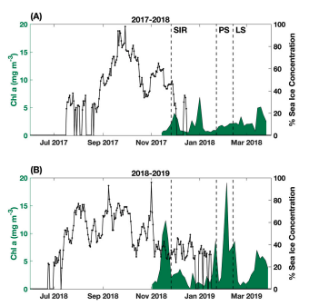
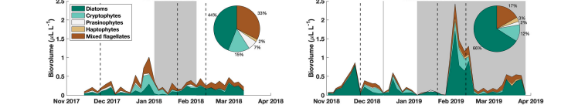
Phenology?
Nardelli et al. 2023 Limnol. Oceanogr.

Slide 15
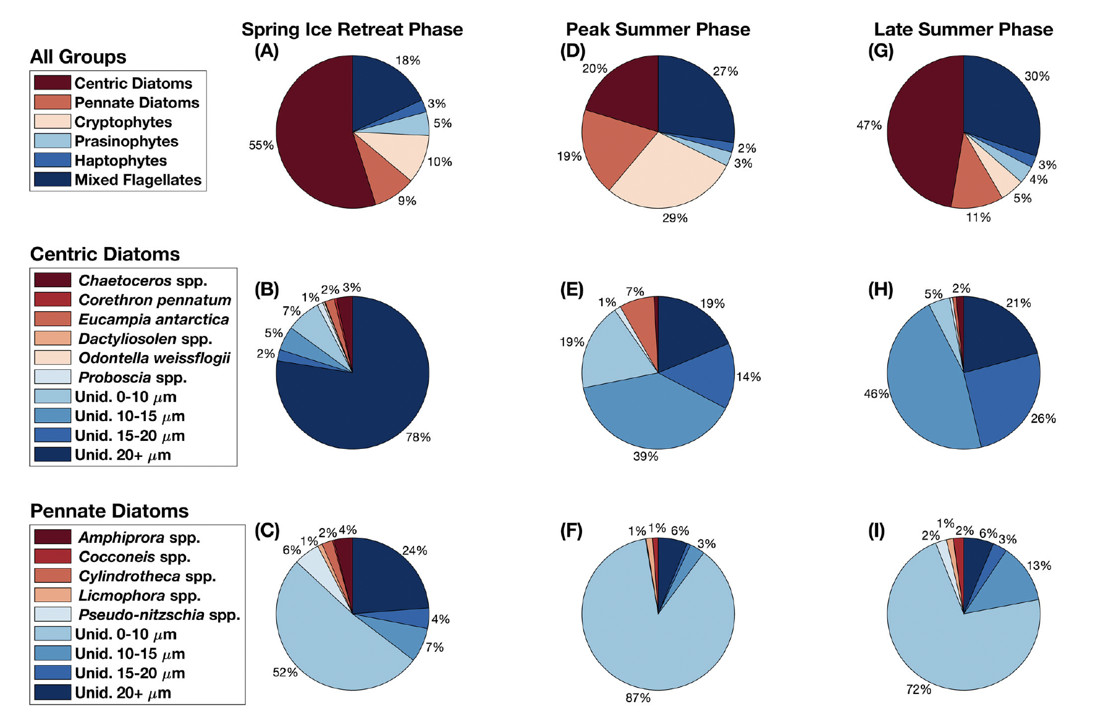

Slide 16
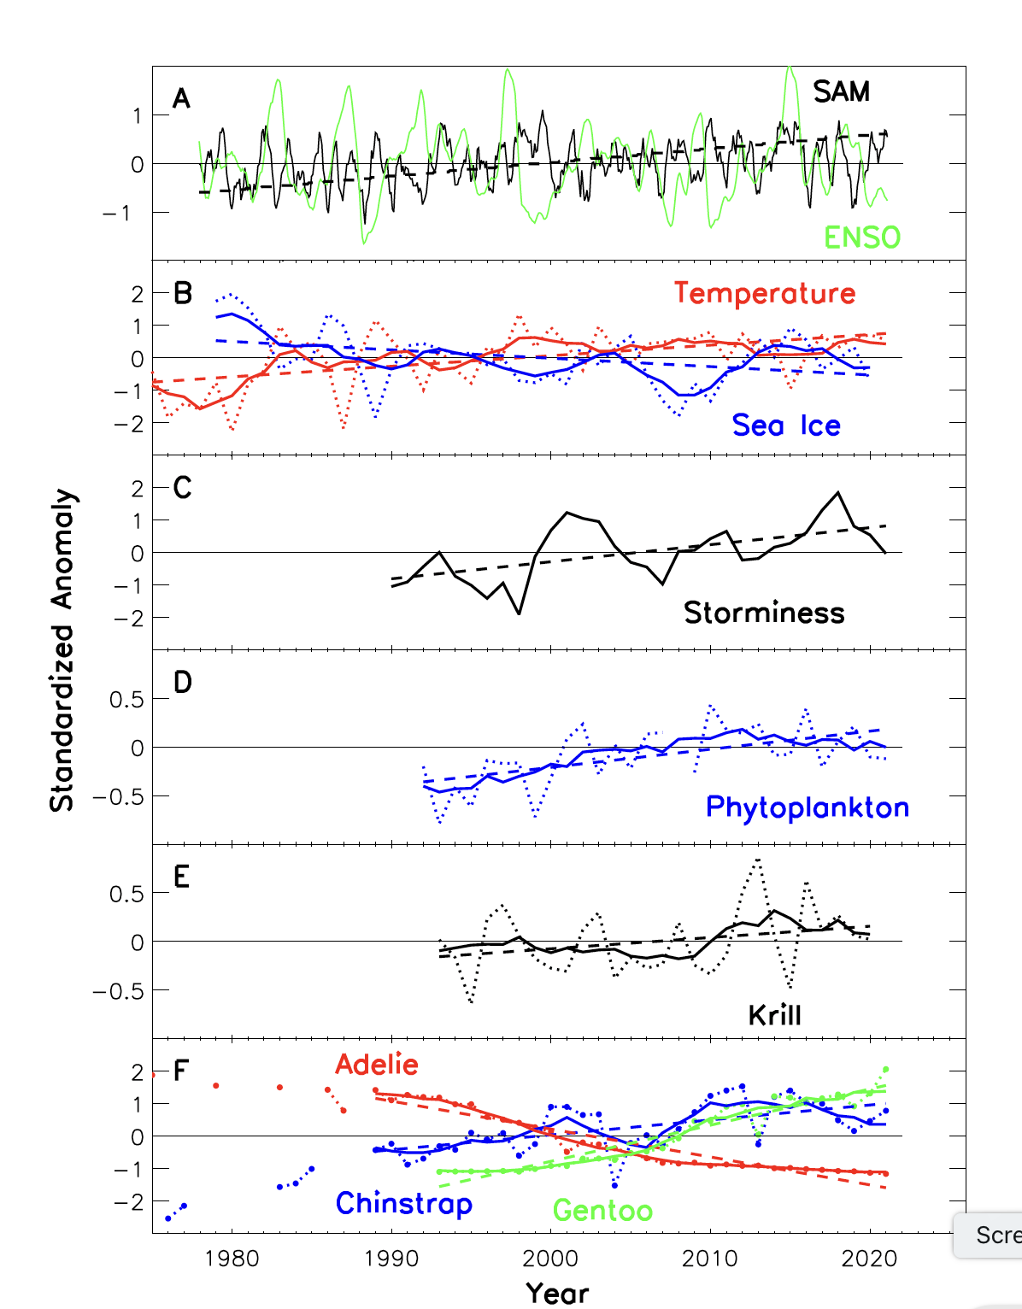
Large Changes Overtime
-Extreme years and the biological response remains an open question. Will we reach a new ecosystem states?
-As the system is changing we can see biomass changes and associated physiological fingerprints of the change.
-We find similar similar dynamics despite differences in sea ice concentrations.
-Need to transition to a species dynamic.

